Slide 1

Overview
QuickSort
Design and Analysis of Algorithms I

Slide 2
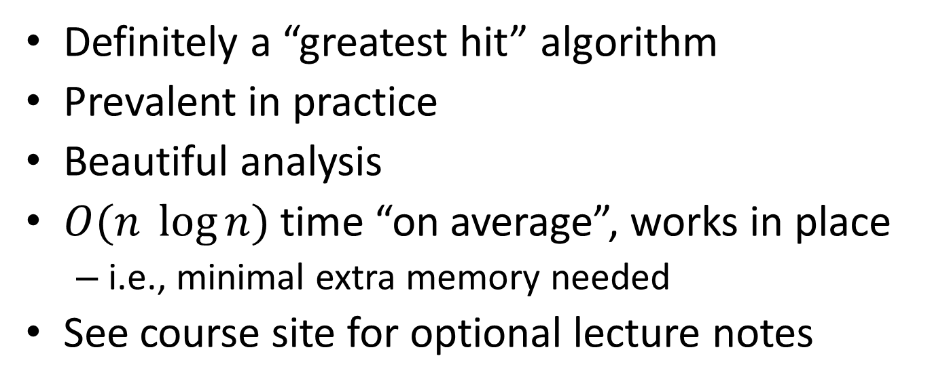
QuickSort
Definitely a “greatest hit” algorithm
Prevalent in practice
Beautiful analysis
$O(n \log{n})$ time “on average”, works in place
i.e., minimal extra memory needed
See course site for optional lecture notes

Slide 3
The Sorting Problem

Slide 4
Partitioning Around a Pivot

Slide 5
Two Cool Facts About Partition

Slide 6
QuickSort: High-Level Description

Slide 7
Outline of QuickSort Videos
The Partition subroutine
Correctness proof [optional]
Choosing a good pivot
Randomized QuickSort
Analysis
A Decomposition Principle
The Key Insight
Final Calculations

